Slide 1


Structuring the Unstructured
Advanced Document Parsing
for AI Workflows
General Deck: 2025
Cedric Clyburn
Senior Developer Advocate
@cedricclyburn

Slide 2
We’ve got a lot to cover today!

Slide 3



We’ve got a lot to cover today!
Wait, so 85% of the world’s data is… unstructured?!

Slide 4


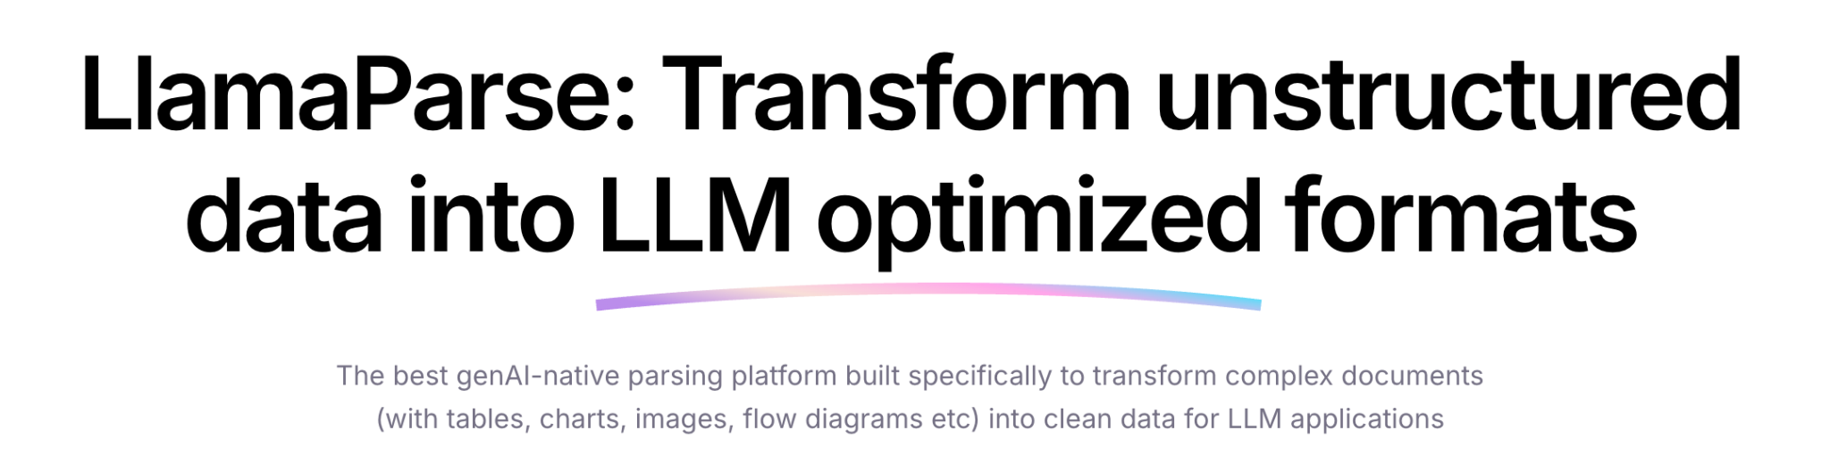
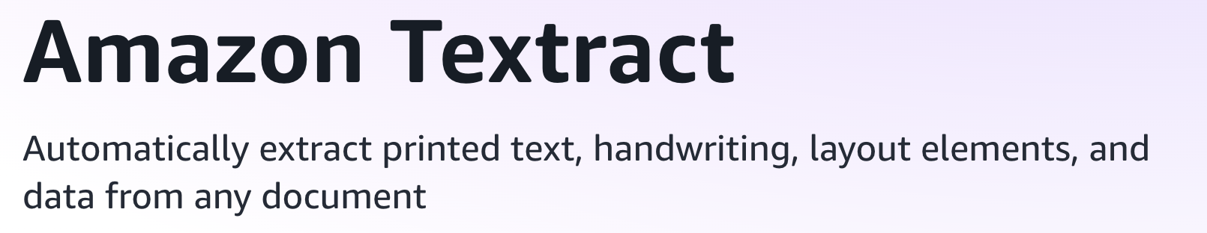
We’ve got a lot to cover today!
But current solutions are proprietary, and require sending your private data!
Wait, so 85% of the world’s data is… unstructured?!

Slide 5
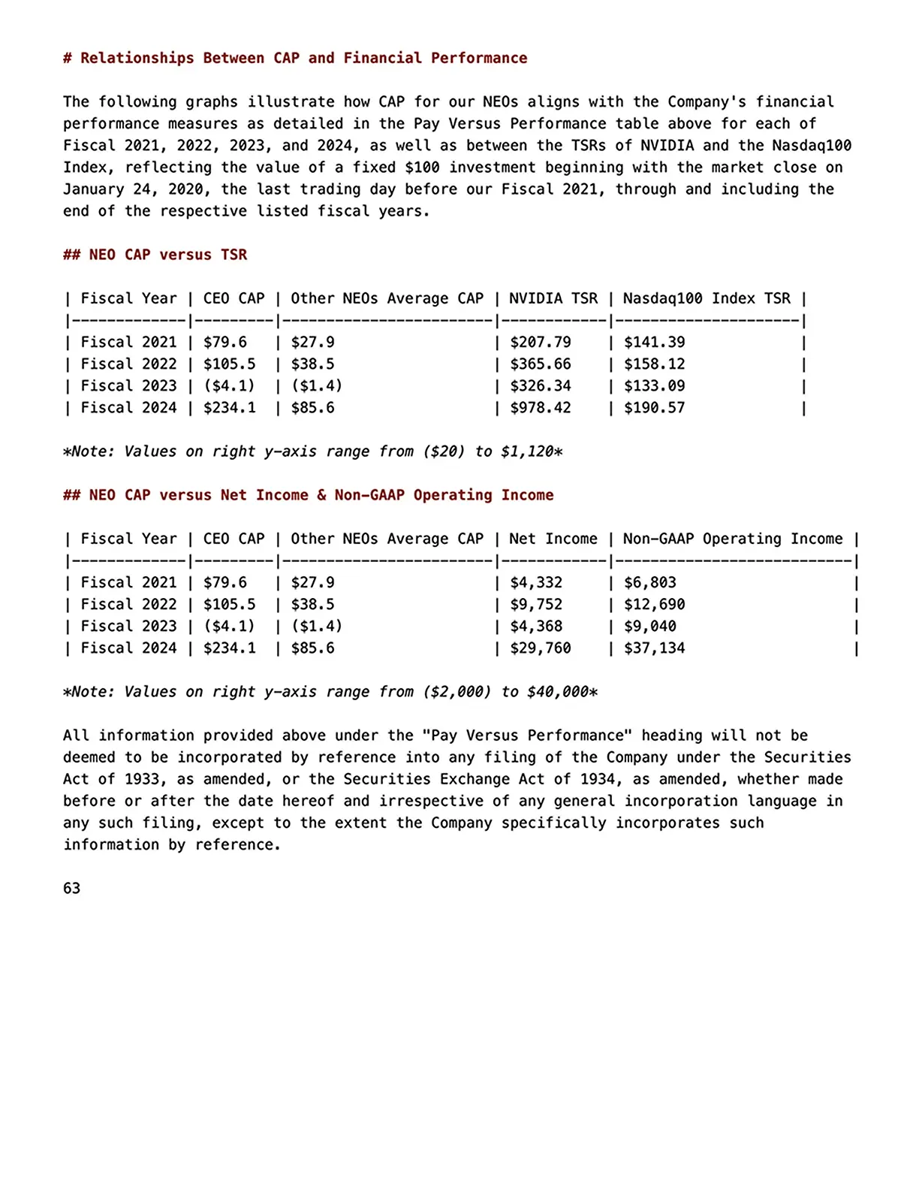
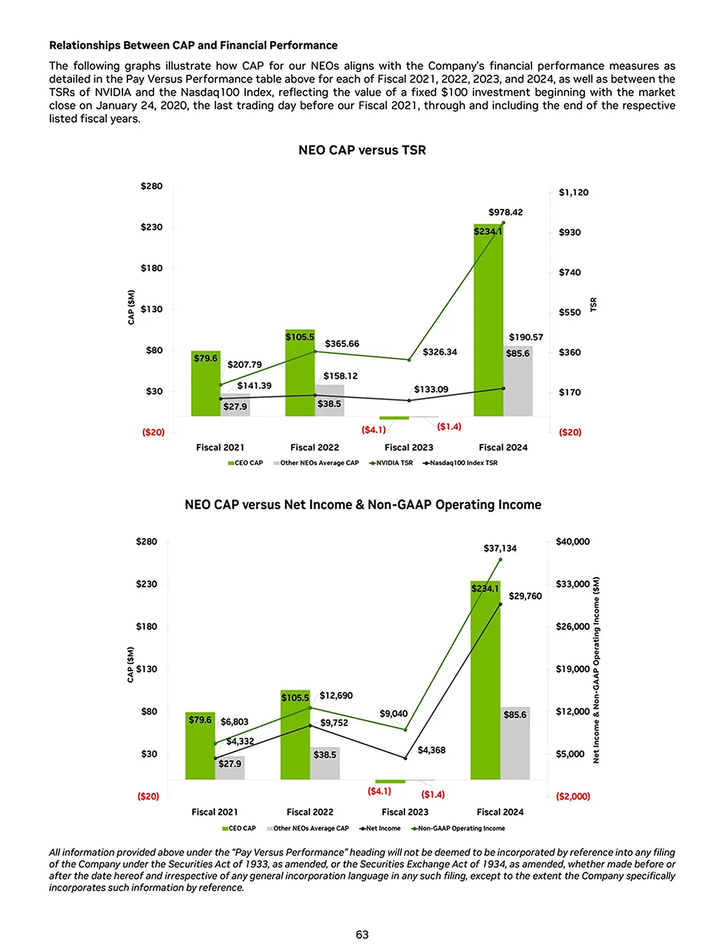
We’ve got a lot to cover today!
But current solutions are proprietary, and require sending your private data!
Wait, so 85% of the world’s data is… unstructured?!
So, how can we easily parse documents, graphs, tables, etc to formats for LLMs?

Slide 6
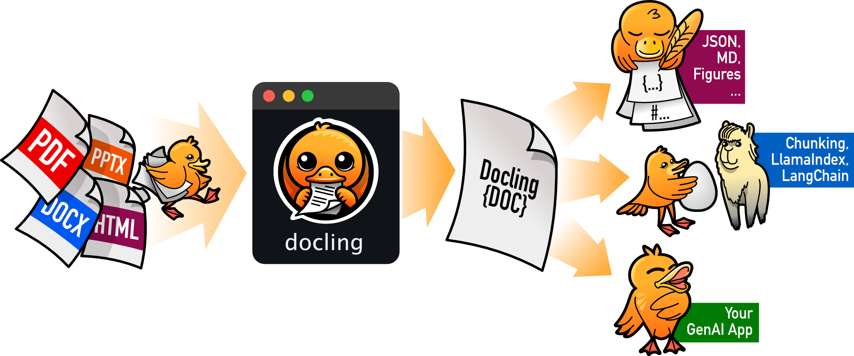
We’ve got a lot to cover today!
But current solutions are proprietary, and require sending your private data!
Wait, so 85% of the world’s data is… unstructured?!
let’s learn about extraction, parsing, chunking, and much more!
So, how can we easily parse documents, graphs, tables, etc to formats for LLMs?

Slide 7

Today’s Schedule
Agenda
Data Preparation for AI: It’s not easy!
Parsing PDF’s, tables, images, etc.
Building an AI document pipeline
Demo #1: Extracting/Parsing Unstructured Data
Demo #2: Chunking & Embedding
Demo #3: Building & Deploying a Q&A app!
Session Slides
red.ht/structuring

Slide 8
Why’s there a need for advanced document processing?

Slide 9
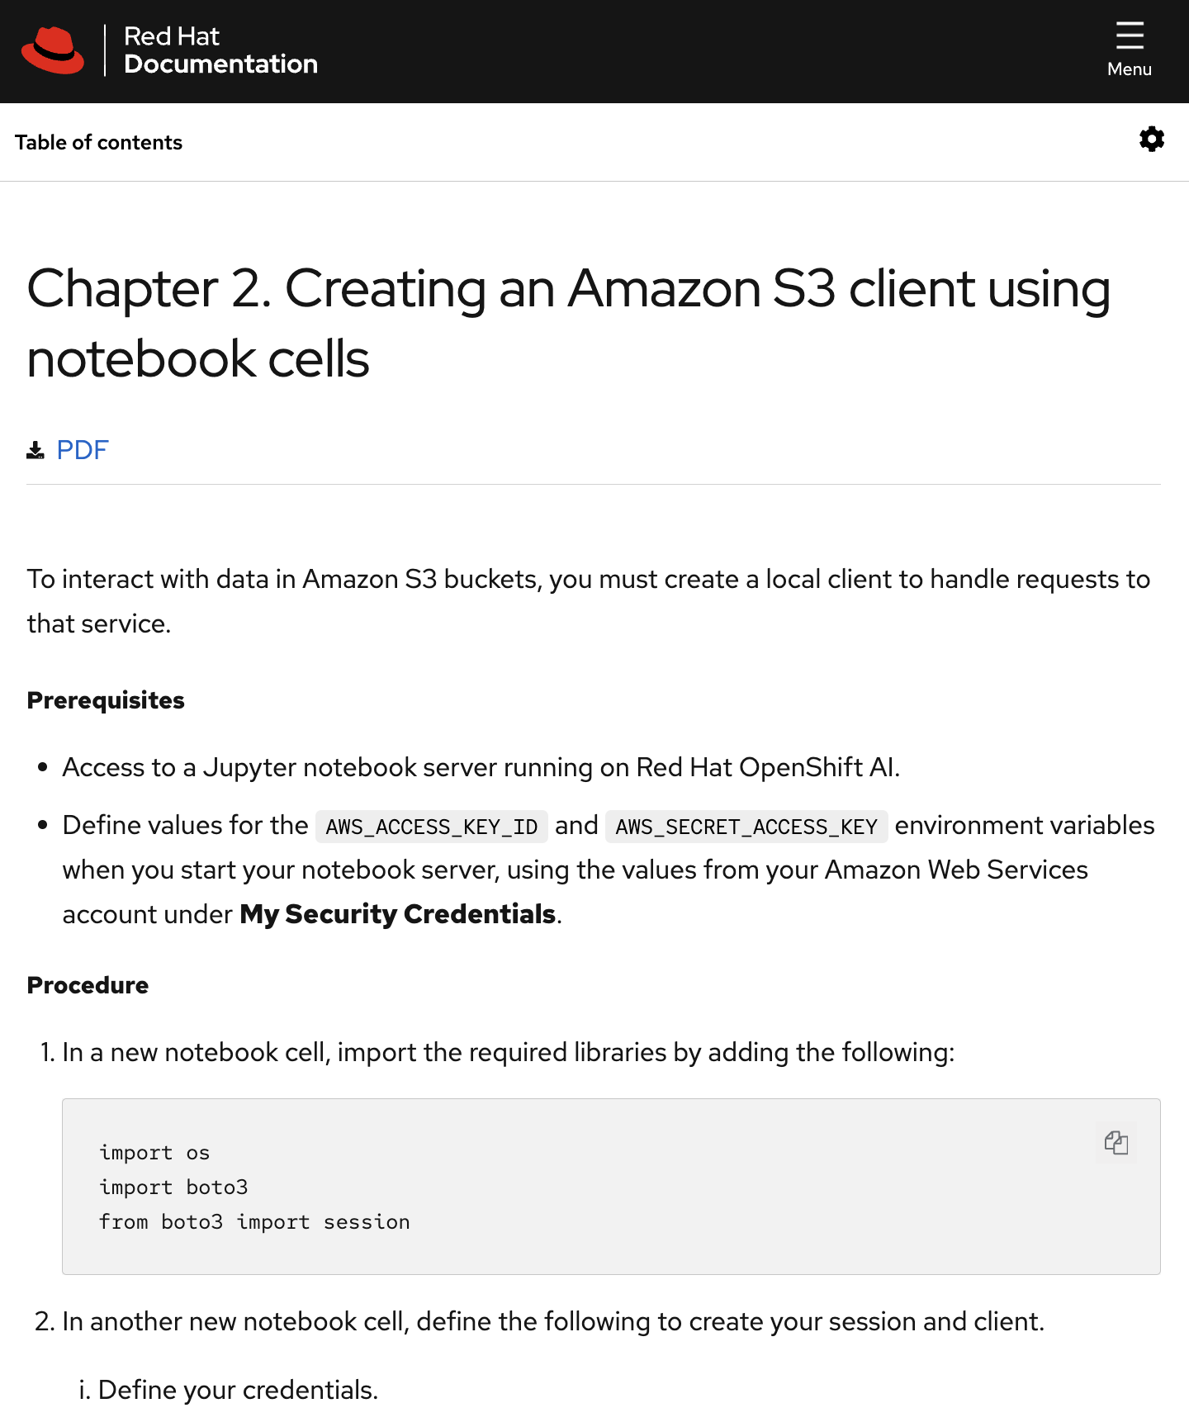
Data is the key ingredient behind AI applications!
Technical Documentation

Slide 10
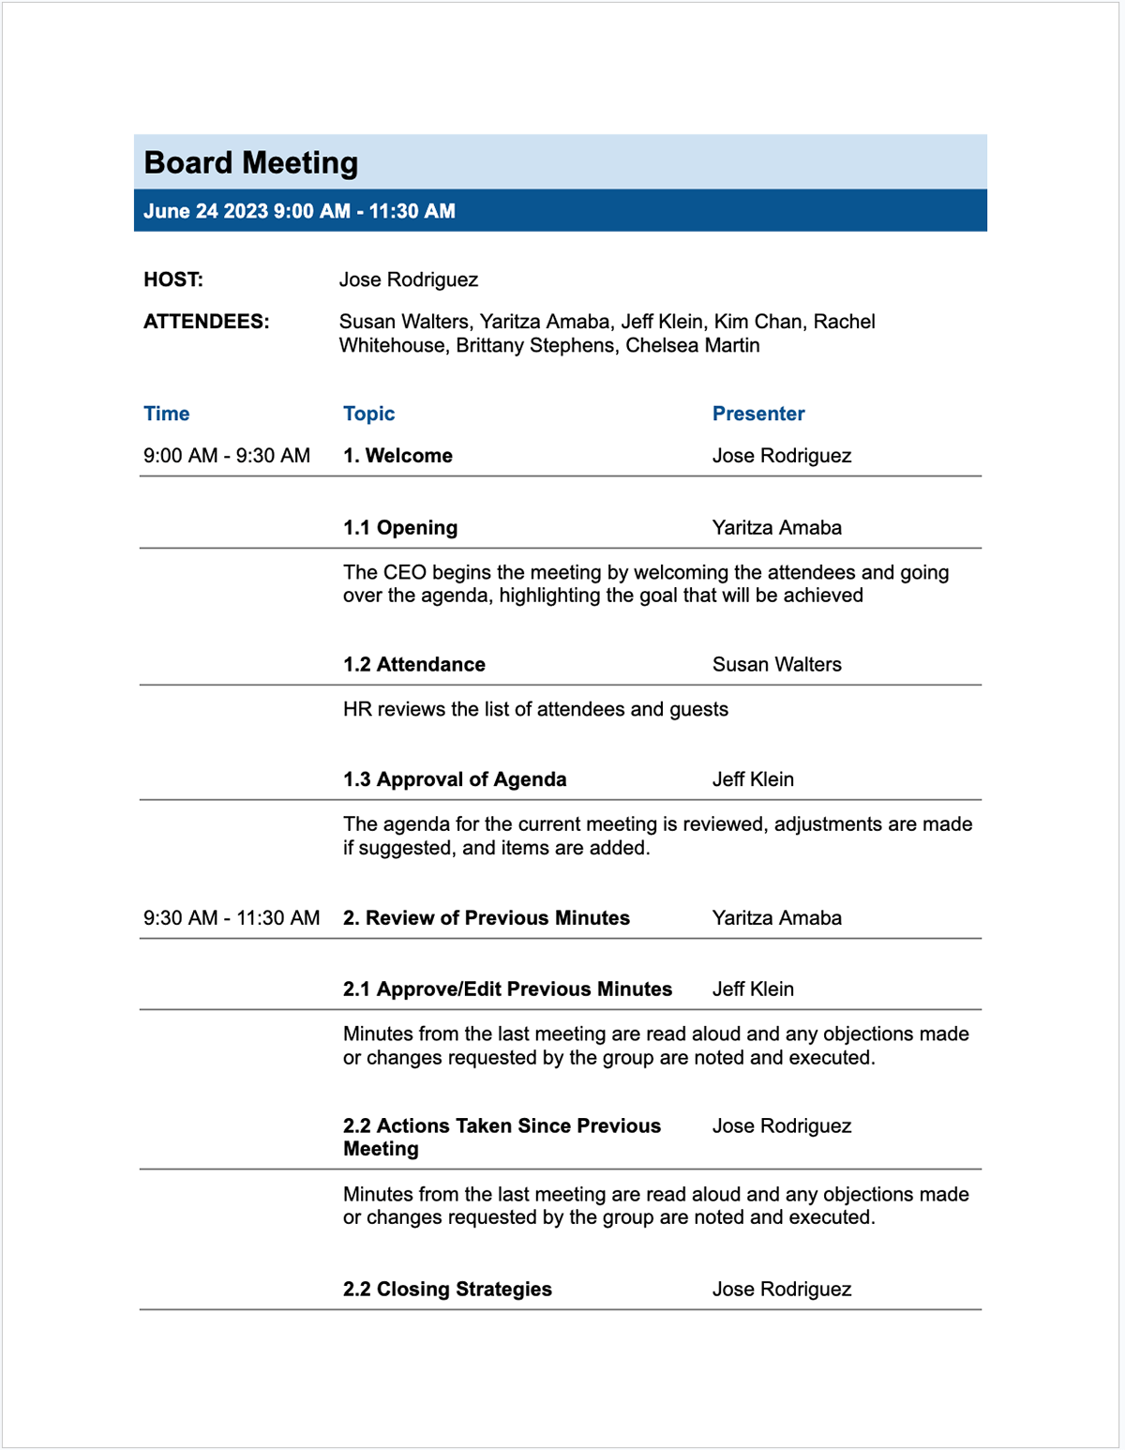
Data is the key ingredient behind AI applications!
Technical Documentation
Meeting Minutes

Slide 11
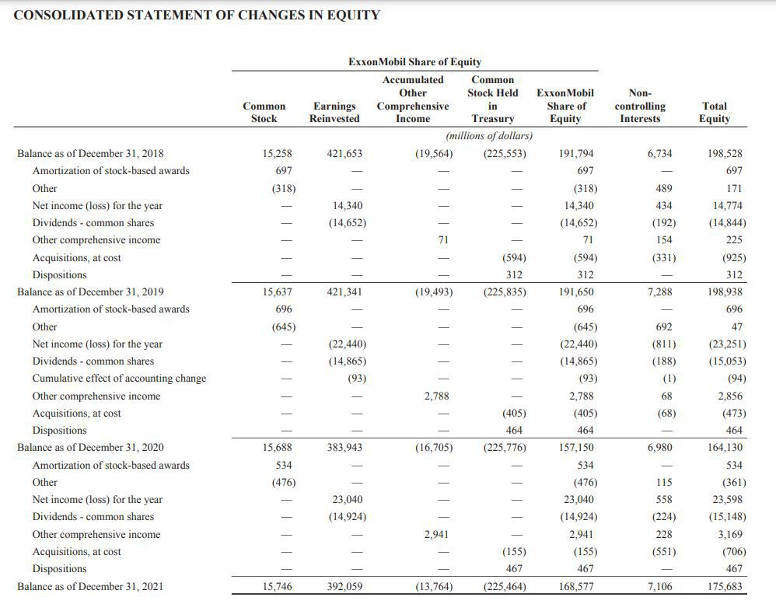
Data is the key ingredient behind AI applications!
Financial Documents
Technical Documentation
Meeting Minutes

Slide 12
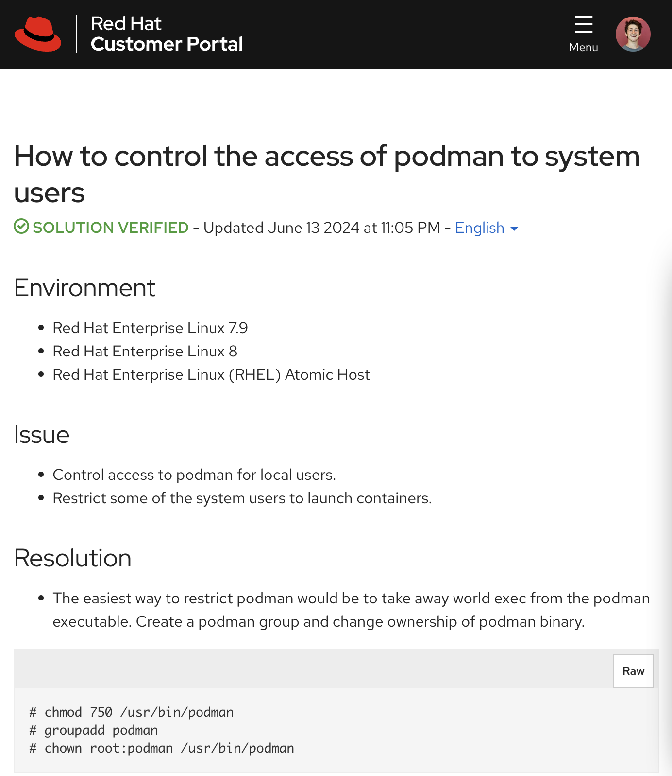
Data is the key ingredient behind AI applications!
Financial Documents
Technical Documentation
Meeting Minutes
Knowledge Base Articles

Slide 13
Data is the key ingredient behind AI applications!
Financial Documents
Technical Documentation
Meeting Minutes
+ much more!
Knowledge Base Articles

Slide 14
Data is the key ingredient behind AI applications!
Powering: RAG (Document Q&A)
Fine-Tuning
etc.
Financial Documents
Meeting Minutes
Technical Documentation
+ much more!
Knowledge Base Articles

Slide 15










Data is the key ingredient behind AI applications!
Powering: RAG (Document Q&A)
Fine-Tuning
etc.
Financial Documents
Meeting Minutes
Technical Documentation
+ much more!
Knowledge Base Articles

Slide 16
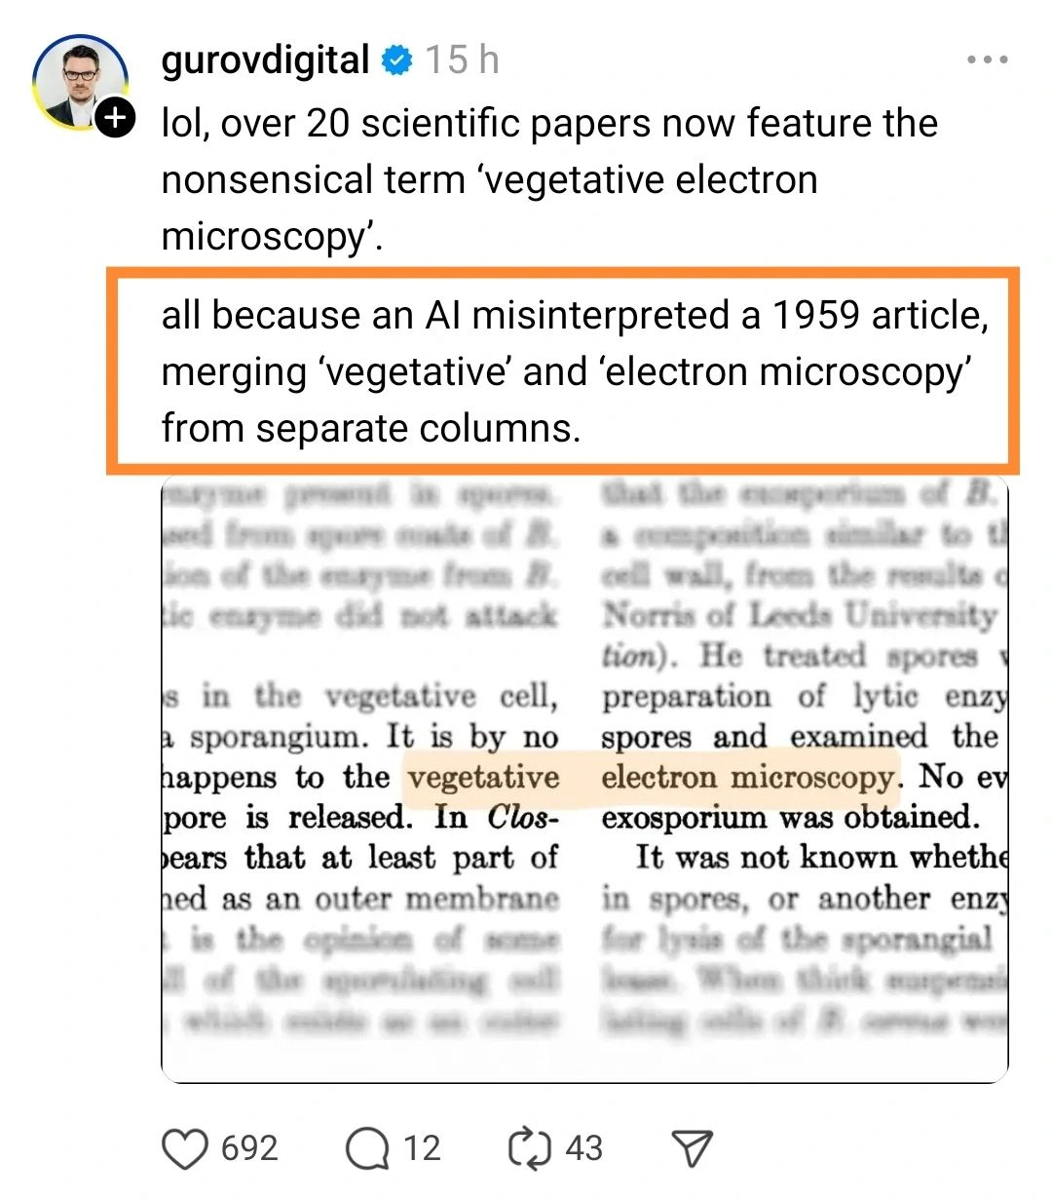
Data processing & prep is quite important!

Slide 17
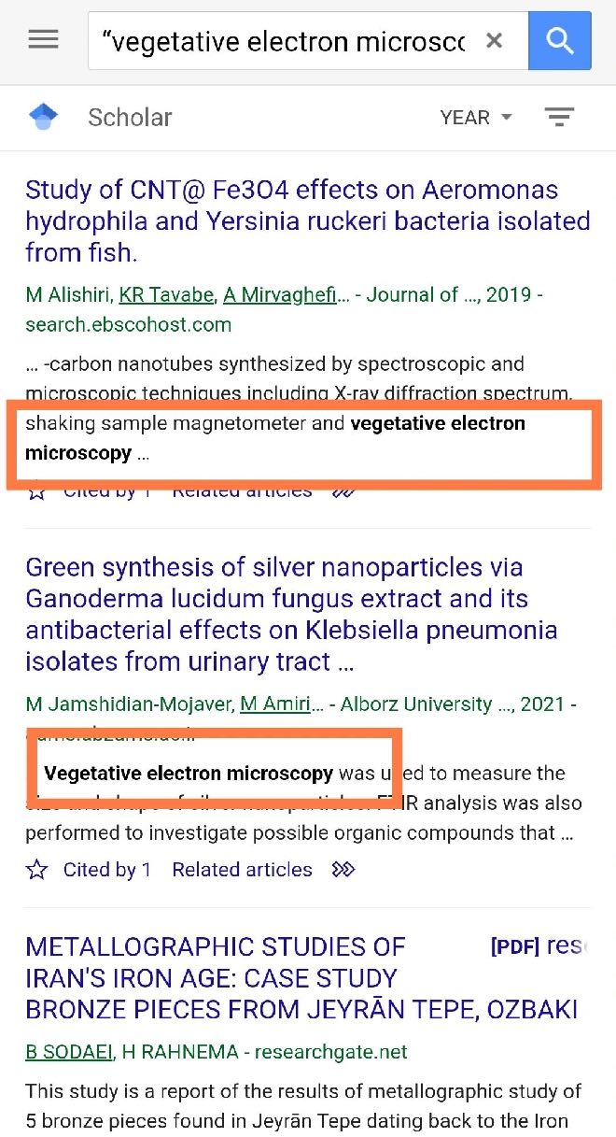
Data processing & prep is quite important!

Slide 18
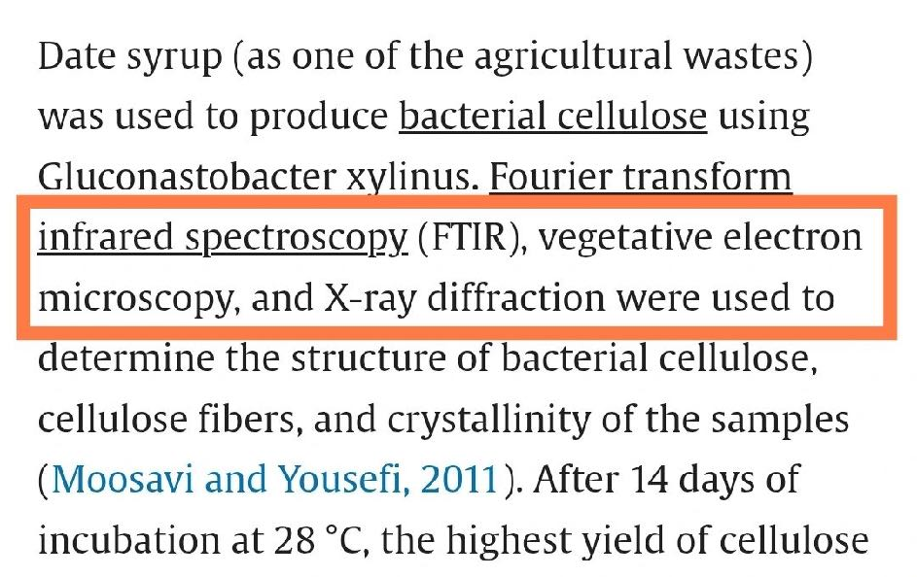
Data processing & prep is quite important!

Slide 19
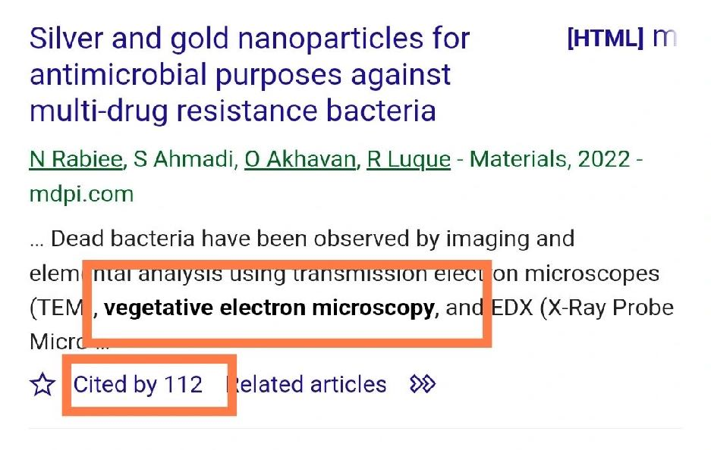
Data processing & prep is quite important!

Slide 20
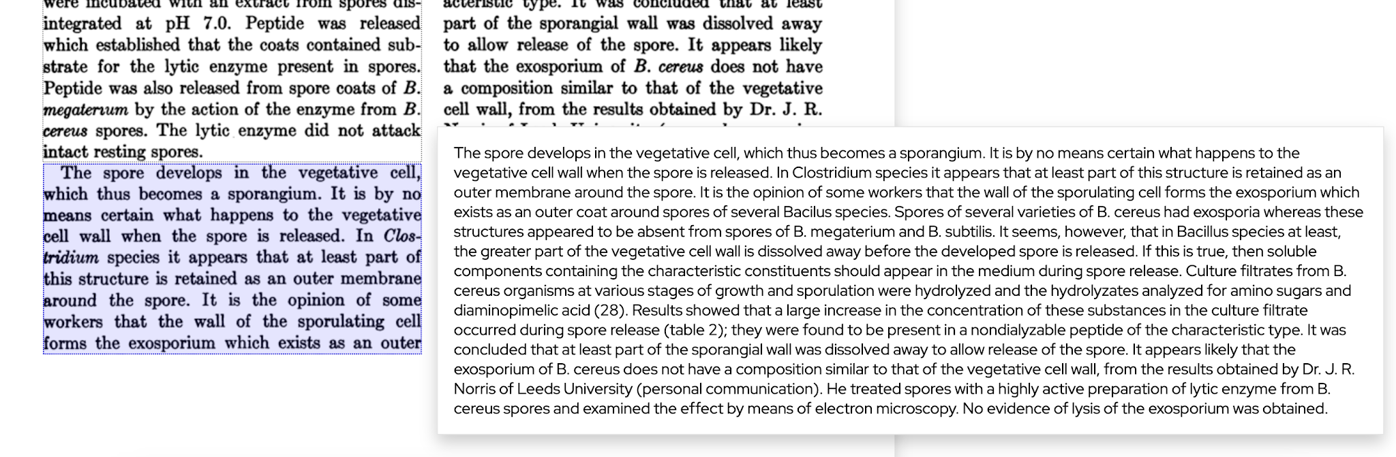

Data processing & prep is quite important!

Slide 21
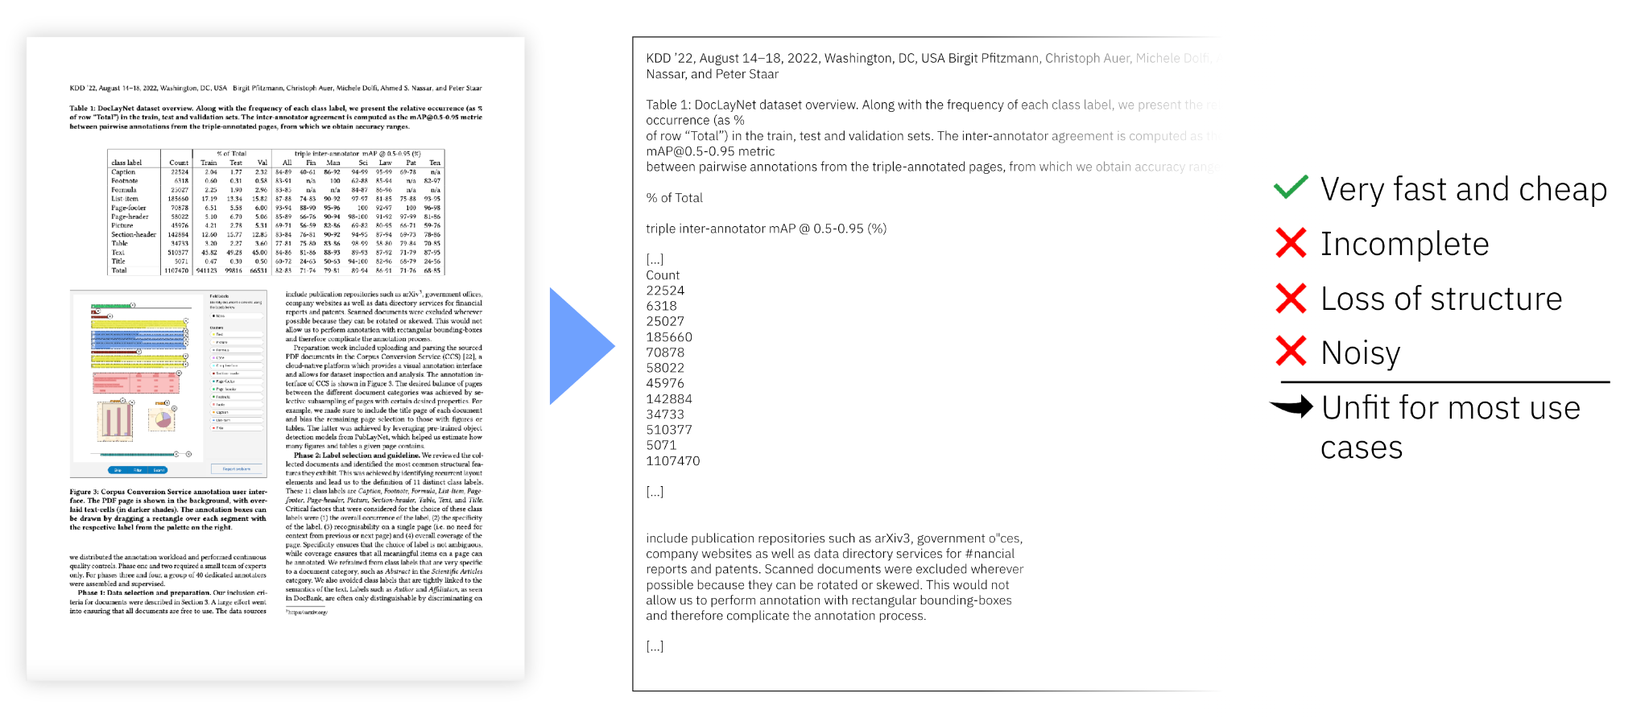
So, let’s try a simple PDF parser…

Slide 22
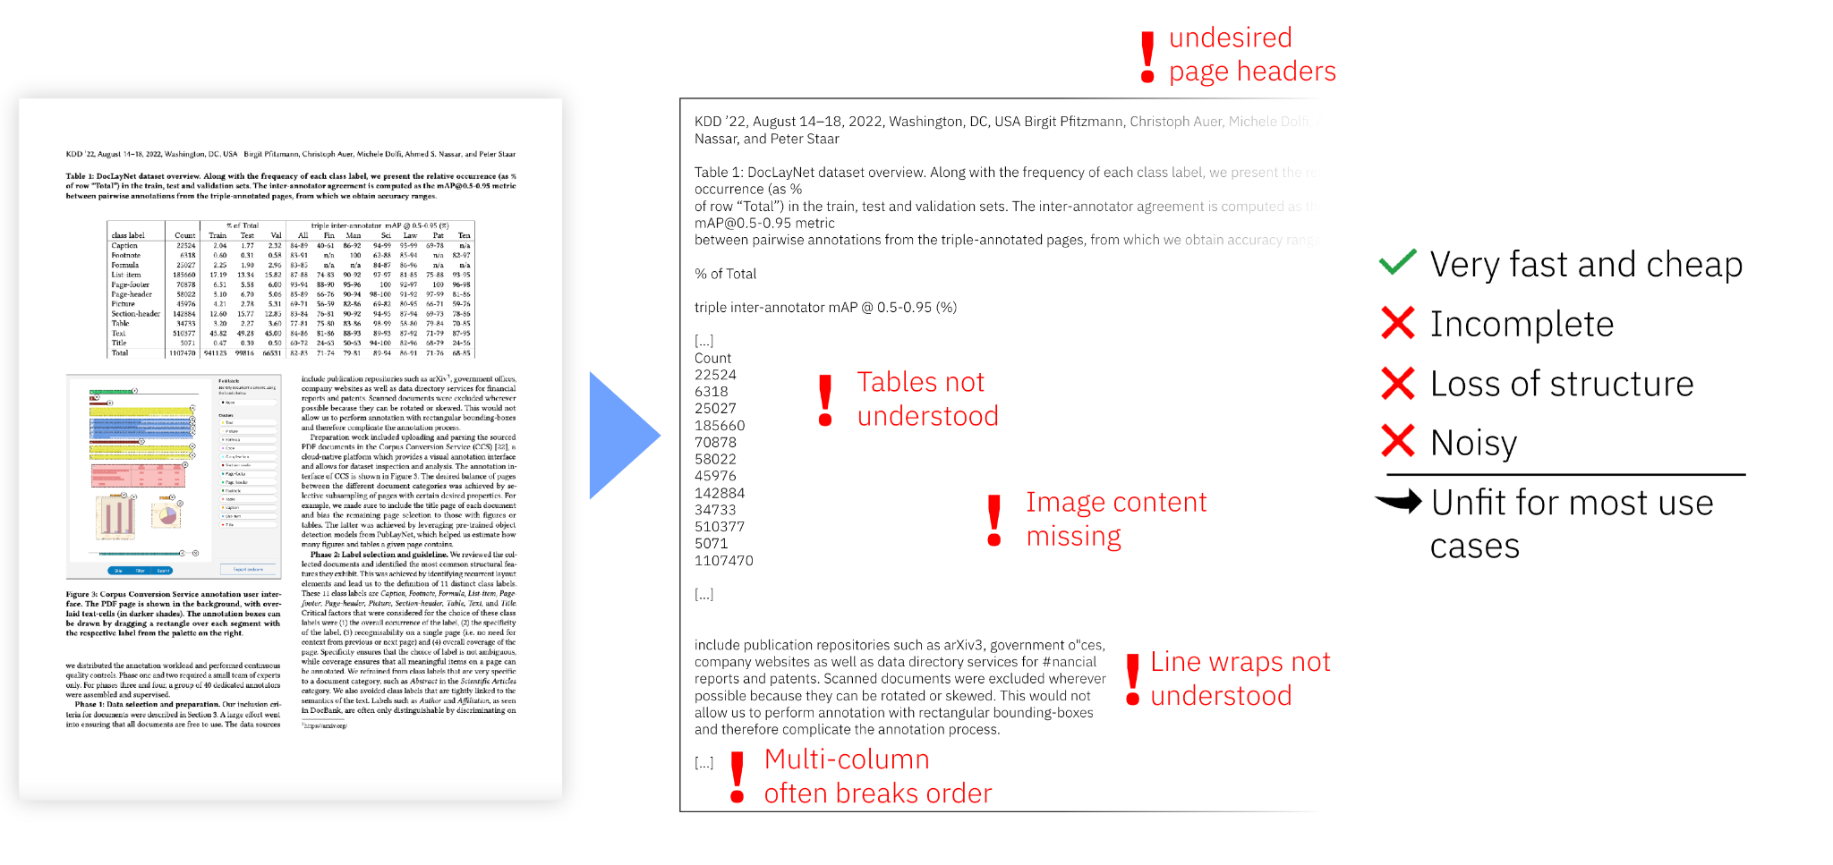
So, let’s try a simple PDF parser… okay that won’t cut it!

Slide 23
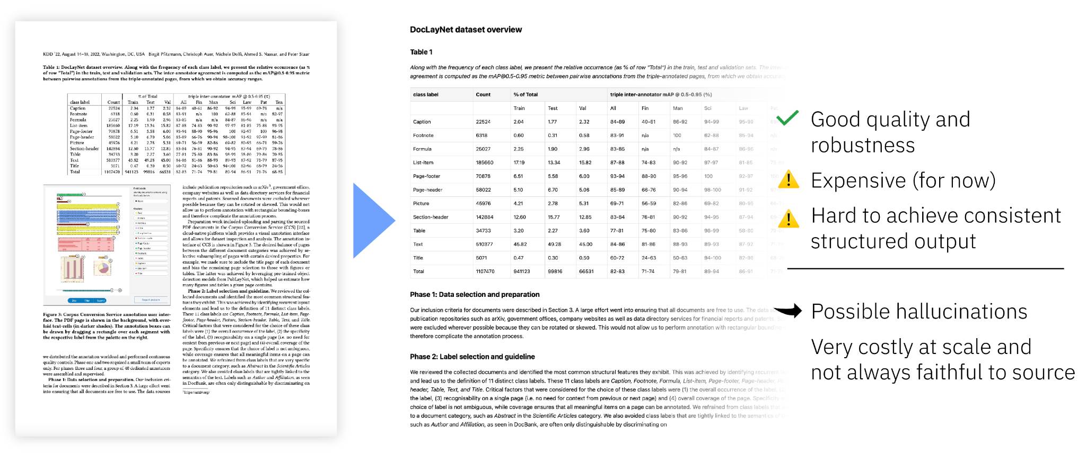
But powerful frontier models? Not bad!

Slide 24

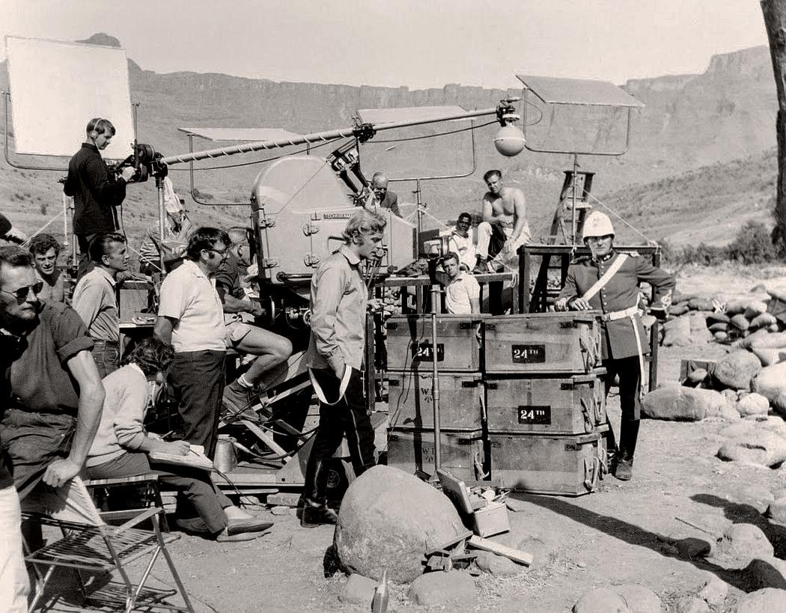

What’s happening behind the scenes?

Slide 25
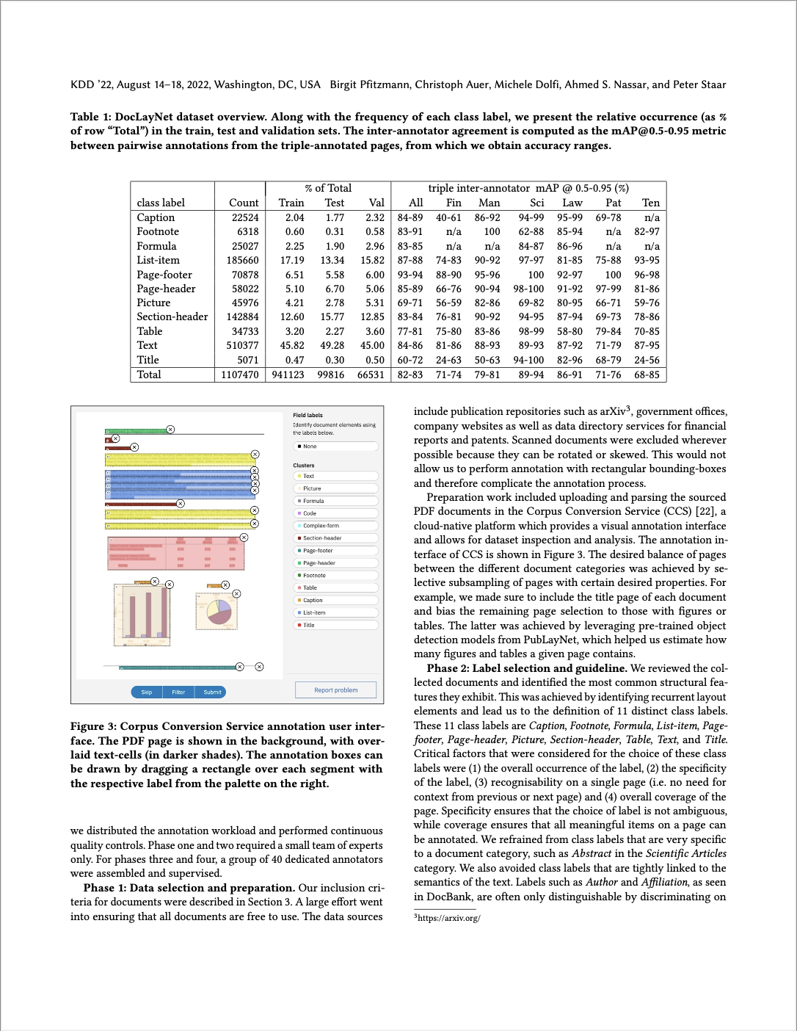

Uncovering the document layout
Docling-Parse, an implementation based on DocLayNet https://arxiv.org/pdf/2206.01062
Original
SmolDocling: An ultra-compact vision-language model for end-to-end multi-modal document conversion https://arxiv.org/pdf/2503.11576 (2025)
Optimized Table Tokenization for Table Structure Recognition https://arxiv.org/pdf/2305.03393 (2023) DocLayNet https://arxiv.org/pdf/2206.01062 (2022)
Docling Parse https://github.com/docling-project/docling-parse

Slide 26
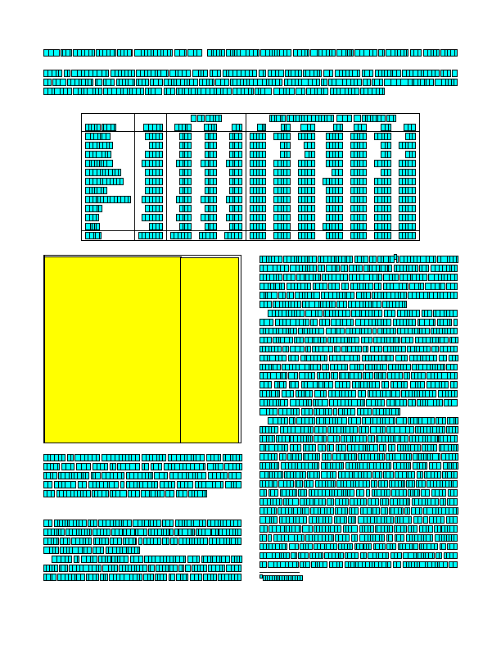
Uncovering the document layout
Docling-Parse, an implementation based on DocLayNet https://arxiv.org/pdf/2206.01062
Original
Char
SmolDocling: An ultra-compact vision-language model for end-to-end multi-modal document conversion https://arxiv.org/pdf/2503.11576 (2025)
Optimized Table Tokenization for Table Structure Recognition https://arxiv.org/pdf/2305.03393 (2023) DocLayNet https://arxiv.org/pdf/2206.01062 (2022)
Docling Parse https://github.com/docling-project/docling-parse

Slide 27

Uncovering the document layout
Docling-Parse, an implementation based on DocLayNet https://arxiv.org/pdf/2206.01062
Original
Char
Word
SmolDocling: An ultra-compact vision-language model for end-to-end multi-modal document conversion https://arxiv.org/pdf/2503.11576 (2025)
Optimized Table Tokenization for Table Structure Recognition https://arxiv.org/pdf/2305.03393 (2023) DocLayNet https://arxiv.org/pdf/2206.01062 (2022)
Docling Parse https://github.com/docling-project/docling-parse

Slide 28

Uncovering the document layout
Docling-Parse, an implementation based on DocLayNet https://arxiv.org/pdf/2206.01062
Original
Char
Word
Line
SmolDocling: An ultra-compact vision-language model for end-to-end multi-modal document conversion https://arxiv.org/pdf/2503.11576 (2025)
Optimized Table Tokenization for Table Structure Recognition https://arxiv.org/pdf/2305.03393 (2023) DocLayNet https://arxiv.org/pdf/2206.01062 (2022)
Docling Parse https://github.com/docling-project/docling-parse

Slide 29

Uncovering the document layout (w/vision models)
Using specialized vision models for document conversion
Smol LM v2 >>> Smol VLM >>> SmolDocling
SmolDocling-256M-preview
SmolDocling is a multimodal Image-Text-to-Text model designed for efficient document conversion.
SmolLM v2 (135M base)
SmolDocling-256M-preview
SmolLM v2 (135M-Instruct)
📐 Layout and Localization
💻 Code Recognition
🔢 Formula Recognition
📊 Chart Recognition
📑 Table Recognition
🖼️ Figure Classification
📝 Caption Correspondence
📜 List Grouping
📂 Scientific and Non-scientific Document Processing
SmolVLM (256M-Instruct)
https://huggingface.co/blog/smolervlm
https://huggingface.co/papers/2503.11576
SmolDocling: An ultra-compact vision-language model for end-to-end multi-modal document conversion https://arxiv.org/pdf/2503.11576 (2025)
Optimized Table Tokenization for Table Structure Recognition https://arxiv.org/pdf/2305.03393 (2023) DocLayNet https://arxiv.org/pdf/2206.01062 (2022)
Docling Parse https://github.com/docling-project/docling-parse

Slide 30
Now you have the text… Next let's chunk it!
PURPOSE
Document chunking or document splitting is a technique used in NLP and information retrieval where large text documents are broken down into smaller, more manageable pieces
Fitting text within model context windows
Creating granular units for search & retrieval
Maintaining semantic coherence

Slide 31
Chunking strategies
Splitting by character or token count
Fixed-size chunking

Slide 32
Chunking strategies
Splitting by character or token count
Token count splitting following document natural structures (paragraphs, sections, etc.)
Fixed-size chunking
Semantic chunking

Slide 33
Chunking strategies
Splitting by character or token count
Token count splitting following document natural structures (paragraphs, sections, etc.)
Fixed-size chunking
Semantic chunking
Overlap chunking
Creating chunks with overlapping
content to maintain context

Slide 34
Chunking strategies
Splitting by character or token count
Token count splitting following document natural structures (paragraphs, sections, etc.)
Fixed-size chunking
Semantic chunking
Overlap chunking
Recursive chunking
Creating chunks with overlapping
content to maintain context
Breaking down the document focusing on meaning and content hierarchically

Slide 35
Chunking strategies
Splitting by character or token count
Token count splitting following document natural structures (paragraphs, sections, etc.)
Fixed-size chunking
Semantic chunking
Overlap chunking
Recursive chunking
Hierarchical chunking
Creating chunks with overlapping
content to maintain context
Breaking down the document focusing on meaning and content hierarchically
Uses the document structure information to create
one chunk for each individual document element
(e.g. text, tables, pictures, titles, body, headers, footers, etc.)

Slide 36
Example: Langchain’s RecursiveCharacterTextSplitter
Separators = ['\nclass ', '\ndef ', '\n\tdef ', '\n\n', '\n', ' ', '']
Chunk length = 200
Overlap = 10
Hierarchical Separator
Recursive Splitting
How does it work?
Split text using separators in order while attempting to preserve semantically coherent units (paragraphs, sentences, words, etc.)
Algorithm:
Split the text using the first separator
If resulting chunks are too large, it recursively tries the next separator in the list
Continues the process until chunks are below the specified length

Slide 37
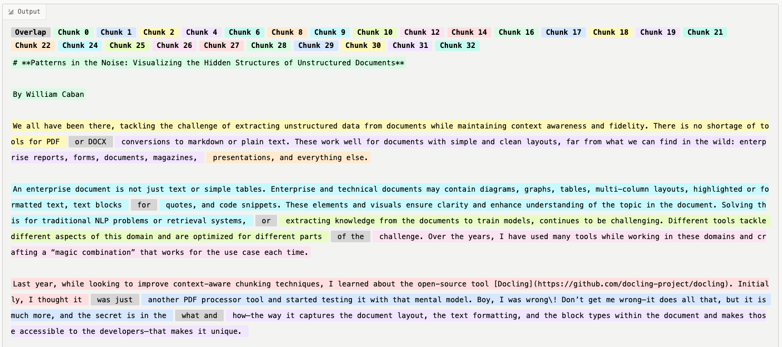
Example: Langchain’s RecursiveCharacterTextSplitter (cont.)
Separators = ['\nclass ', '\ndef ', '\n\tdef ', '\n\n', '\n', ' ', '']
Chunk length = 200
Overlap = 10
Hierarchical Separator
Recursive Splitting
1
2
3
4
5
7
6
8
9
10
11
Chunk Visualizer https://huggingface.co/spaces/m-ric/chunk_visualizer
Blog https://odsc.com/blog/patterns-in-the-noise-visualizing-the-hidden-structures-of-unstructured-documents/

Slide 38
Example: Langchain’s RecursiveCharacterTextSplitter (cont.)
Separators = ['\nclass ', '\ndef ', '\n\tdef ', '\n\n', '\n', ' ', '']
Chunk length = 200
Overlap = 10
Hierarchical Separator
Recursive Splitting
1
2
3
4
5
7
6
Overlaps
8
9
10
11
Chunk Visualizer https://huggingface.co/spaces/m-ric/chunk_visualizer
Blog https://odsc.com/blog/patterns-in-the-noise-visualizing-the-hidden-structures-of-unstructured-documents/

Slide 39
Example: Langchain’s RecursiveCharacterTextSplitter (code)
from langchain_text_splitters import RecursiveCharacterTextSplitter
...
text_splitter = RecursiveCharacterTextSplitter(
separators=['\nclass ', '\ndef ', '\n\tdef ', '\n\n', '\n', ' ', ''], # default to "\n\n"
chunk_size=200,
chunk_overlap=10,
length_function=len,
is_separator_regex=False,
)

Slide 40
Example: Docling’s HybridChunker
Docling’s HybridChunker applies tokenization-aware refinements on top of document-based hierarchical chunking (HierarchicalChunker)
Fixed-size chunking
Semantic chunking
Overlap chunking
Recursive chunking
Hierarchical chunking
DoclingDocument document representation:
Text, Tables, Pictures, and more
Document hierarchy with sections and groups
Disambiguation between main body and headers, footers (furniture)
Layout information (i.e. bounding boxes) for all items, if available
Provenance information
The HierarchicalChunker uses the document structure information from the DoclingDocument to create one chunk for each individual detected document element, by default only merging together list items

Slide 41
Example: Docling’s HybridChunker (cont.)
Prepend title and section information
=== 0 ===
Original Chunk:
'By William Caban\nWe all have been there, tackling the challenge of extracting unstructured data from documents while maintain…'
Enriched Text:
'Patterns in the Noise: Visualizing the Hidden Structures of Unstructured Documents\nBy William Caban\nWe all have been there, t…'
=== 1 ===
Original Chunk:
'An enterprise document is not just text or simple tables. Enterprise and technical documents may contain diagrams, graphs, ta…'
Enriched Text:
'Patterns in the Noise: Visualizing the Hidden Structures of Unstructured Documents\nAn enterprise document is not just text or…'
=== 2 ===
Original Chunk:
'Last year, while looking to improve context-aware chunking techniques, I learned about the open-source tool Docling . Initia…'
Enriched Text:
'Patterns in the Noise: Visualizing the Hidden Structures of Unstructured Documents\nLast year, while looking to improve contex…'
=== 3 ===
Original Chunk:
'Take, for example, a Spanish document from the government of El Salvador https://www.mh.gob.sv . The PDF for the following e…'
Enriched Text:
'Patterns in the Noise: Visualizing the Hidden Structures of Unstructured Documents\nTake, for example, a Spanish document from…'
Chunk is contextualized following document
hierarchy of sections and groups
Blog https://odsc.com/blog/patterns-in-the-noise-visualizing-the-hidden-structures-of-unstructured-documents/

Slide 42
Example: Docling’s HybridChunker (code)
from docling.document_converter import DocumentConverter
from docling.chunking import HybridChunker
...
doc = DocumentConverter().convert(source=DOC_SOURCE).document
chunker = HybridChunker(
tokenizer = "sentence-transformers/all-MiniLM-L6-v2", # default
max_tokens = 200, # default derived from 'tokenizer'
merge_peers = True # default to True
)

Slide 43
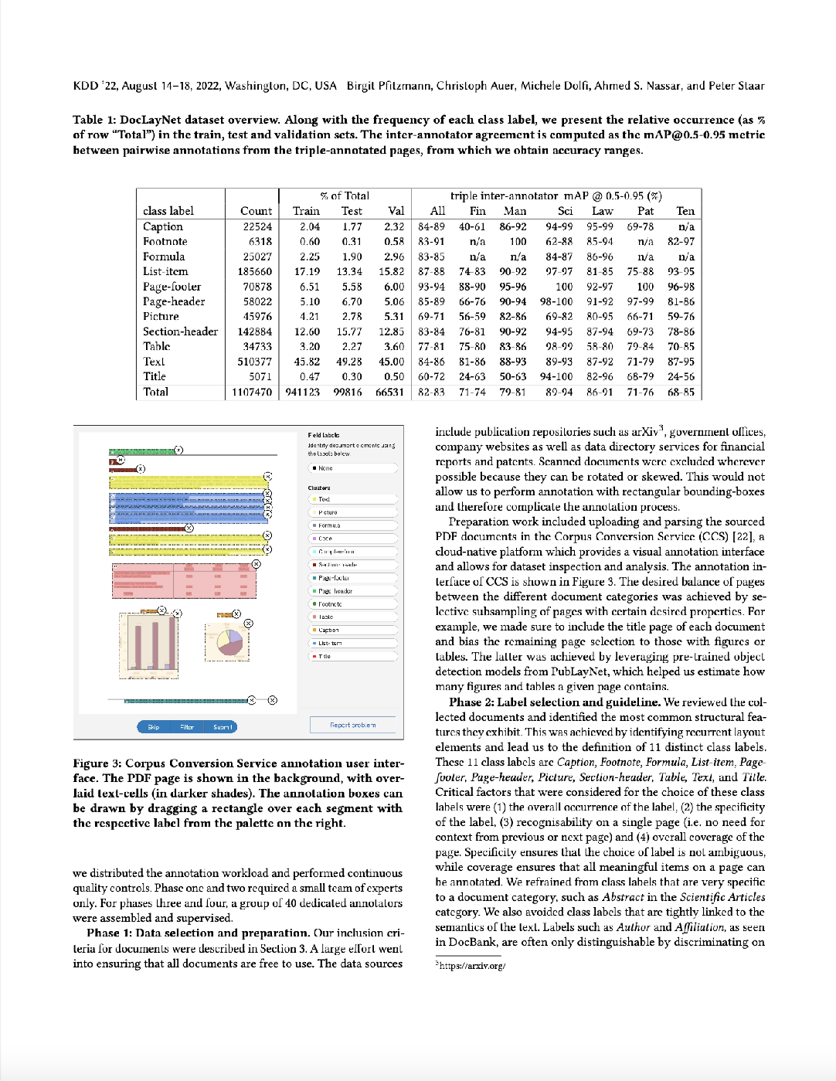
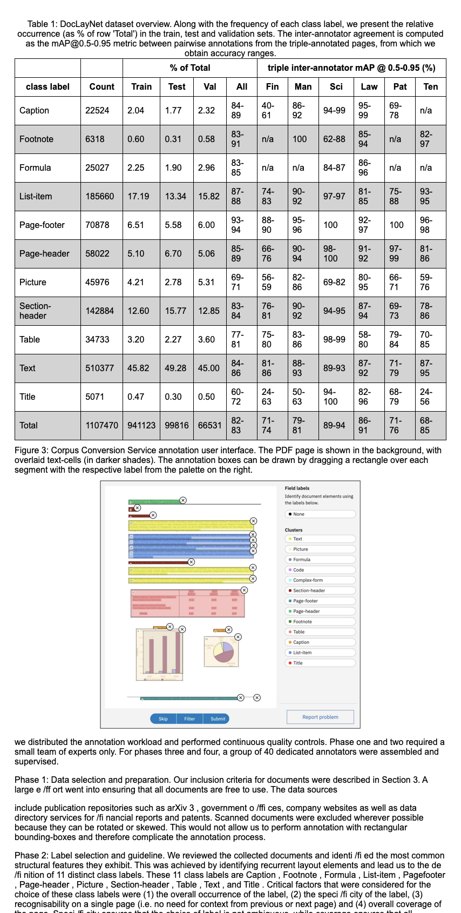
Let’s put it all together
Good quality
Fast and cheap
Fully local operation
Structured format output
Cost-effective at scale, with consistent representation and high quality
*results rendered as HTML for visualization purposes

Slide 44
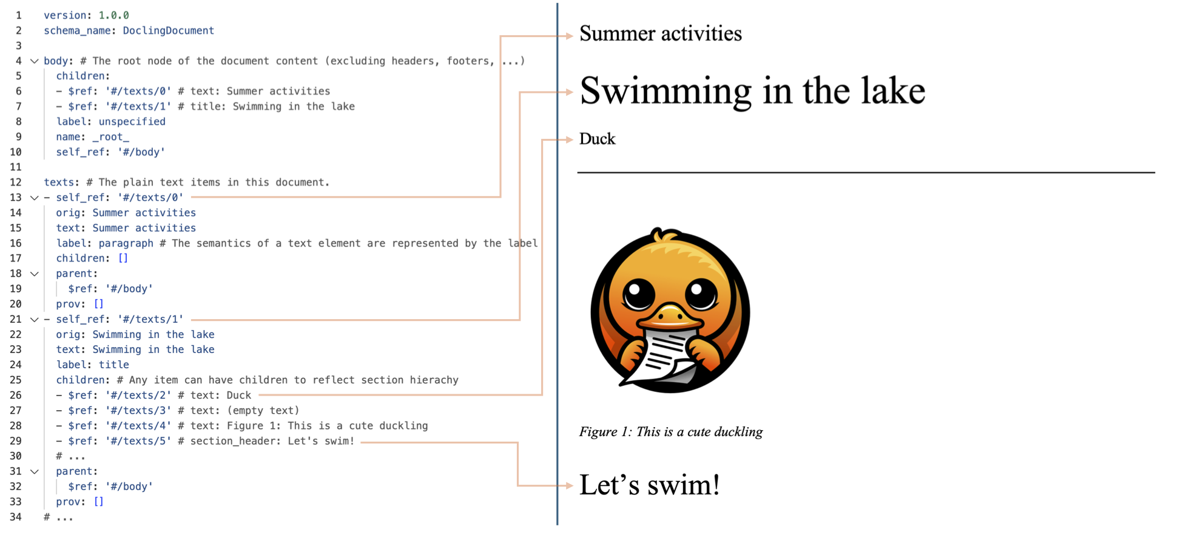
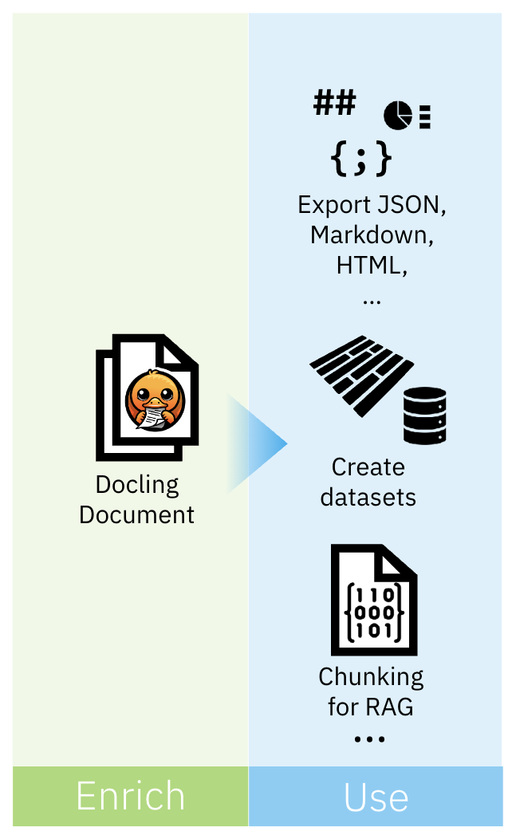
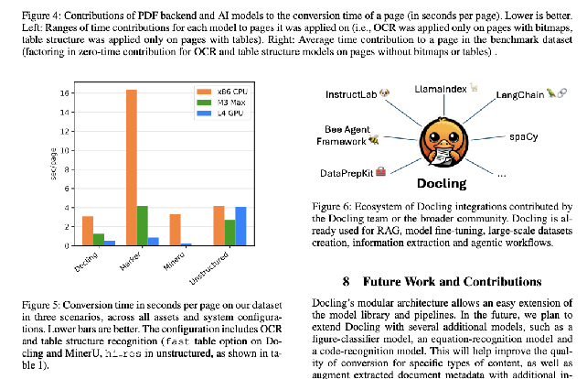
How does it work behind the scenes?
Rich representation of content features including text, tables, pictures, etc.
Figure classification and creation of a textual description of the picture
PictureClassificationClass( class_name='bar_chart’, confidence=0.9999500513076782 )
In this image we can see a bar chart. In the chart we can see the CPU, Max, GPU, and sec/page.

Slide 45


It’s demo time!
Code Repository URL red.ht/odsc-demo

Slide 46
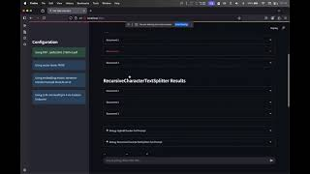
Impact of Chunker in RAG (PDF Q&A with RAG)
Code Repository URL https://github.com/williamcaban/odsc-east-2025 Video https://youtu.be/dNMu5iZR70Q

Slide 47


Thank you! You’re awesome!
Data Preparation for AI: It’s not easy!
Parsing PDF’s, tables, images, etc.
Building an AI document pipeline
Session Slides
red.ht/structuring
Feel free to connect on LinkedIn!

Slide 48
Thank you
Join the DevNation
Red Hat Developer serves the builders. The problem solvers who create careers with code. Let’s keep in touch!
Join Red Hat Developer at developers.redhat.com/register
Follow us on any of our social channels
Visit dn.dev/upcoming for a schedule of our upcoming events
Red Hat Developer
Build here. Go anywhere.

